Slide 1
Am I Looking good?

Slide 2
Project brief
Mobile application which can determine facial beauty from an image.
Few requirements implicit in the brief beyond this.

Slide 3
Researching technologies
Programming languages.
Libraries.
Frameworks.
Design patterns.

Slide 4
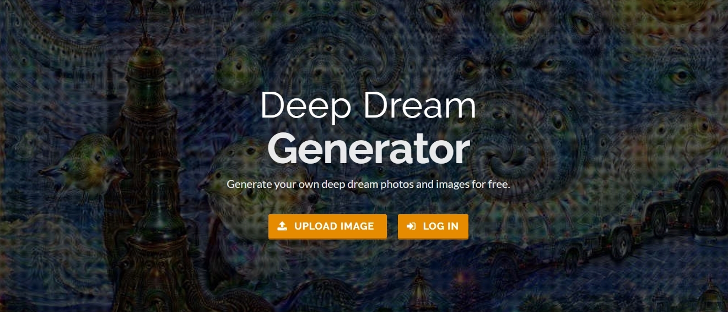
Researching existing solutions
Hot or Not
Google Deepdream
Fit or Fugly

Slide 5
Specifying requirements
Decided to develop for most devices.
Tablets, iPhones, desktop etc.
Courteous way of giving the score.
Speed requirements.

Slide 6
Technologies selected
Node.js server
MATLAB application to score faces
Based on the variety of libraries we found
We still had to do evaluation to determine the best library to pick.

Slide 7
Design and aesthetics
Wanted it to have a novelty/fun feel rather than professional.
Also had to consider devices sizes.
Universal appeal
No one ought to be intimidated by using the application.

Slide 8
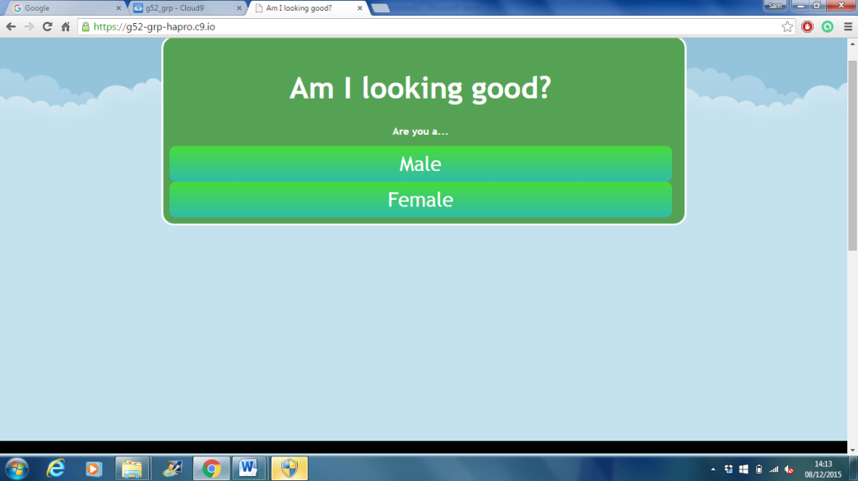

Slide 9
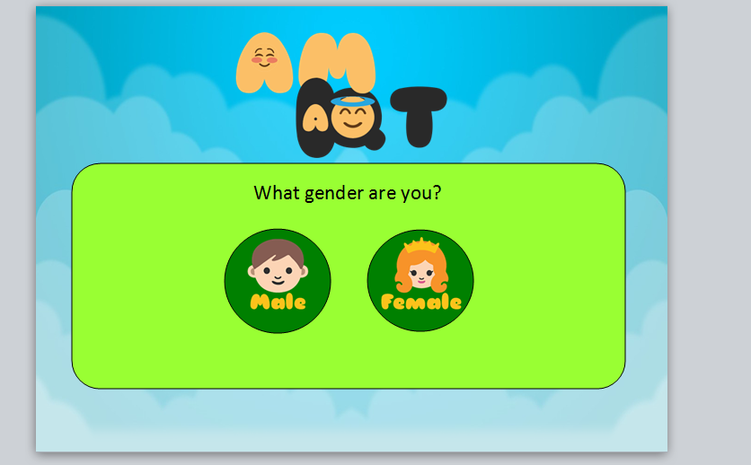

Slide 10
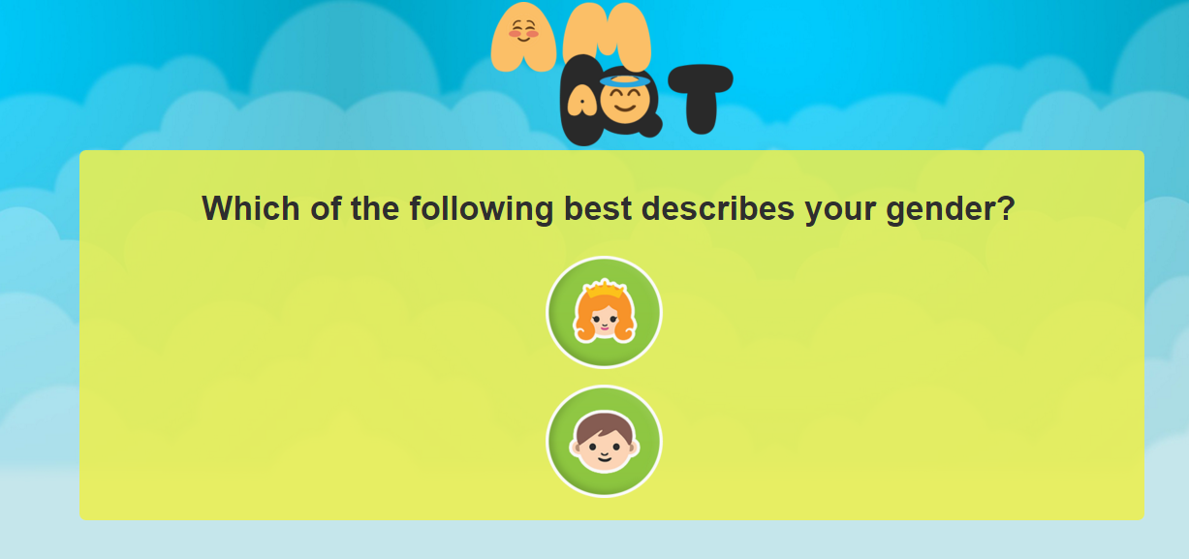

Slide 11
Evaluation and testing - comparative
Look at pros/cons of each library.
Objective criteria, speed, accuracy.
Any other things to note.

Slide 12
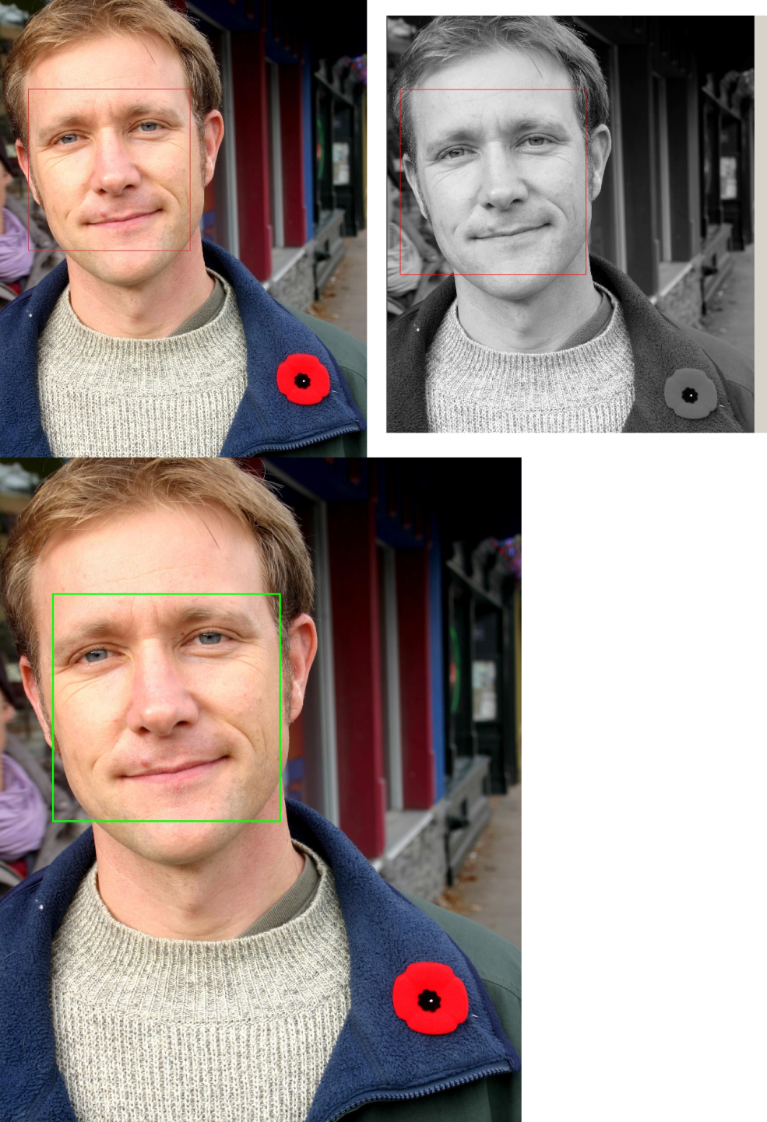
CNNFacepoint
Headhunter
NPD

Slide 13
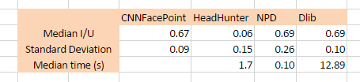
Evaluating face detector

Slide 14
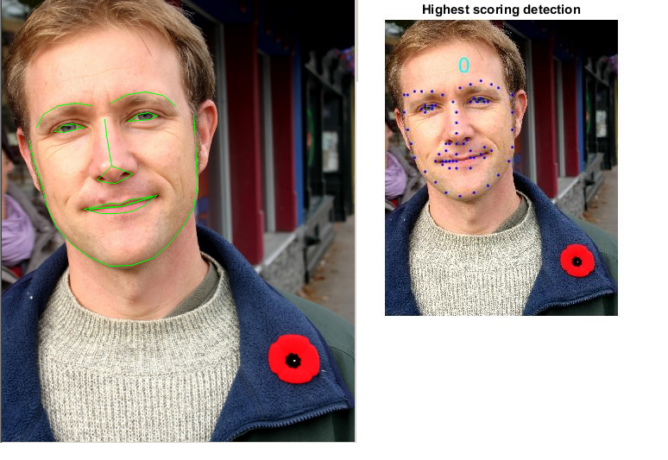
PO-CR
L&W

Slide 15
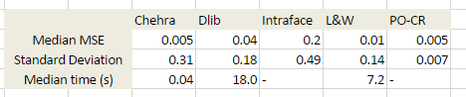
Evaluating feature detectors

Slide 16
How do you determine how attractive someone is?
Key philosophical question for our application.
Age? Complexion? Facial structure?
How do you convert something as complex as a human face into something a computer can understand.

Slide 17
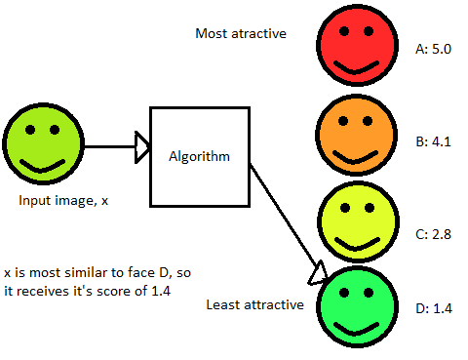
Final system overview
Works by comparing input image to data base of images.
Returns the score associated with the most similar image.

Slide 18
Evaluation of scores produced
Goes back to initial question of how can you objectively measure beauty.
Realized we needed more comprehensive strategy than anecdotally deciding if system produced scores we agreed with.
Therefore we built a database of scored faces, and compared the results produced by our application.

Slide 19
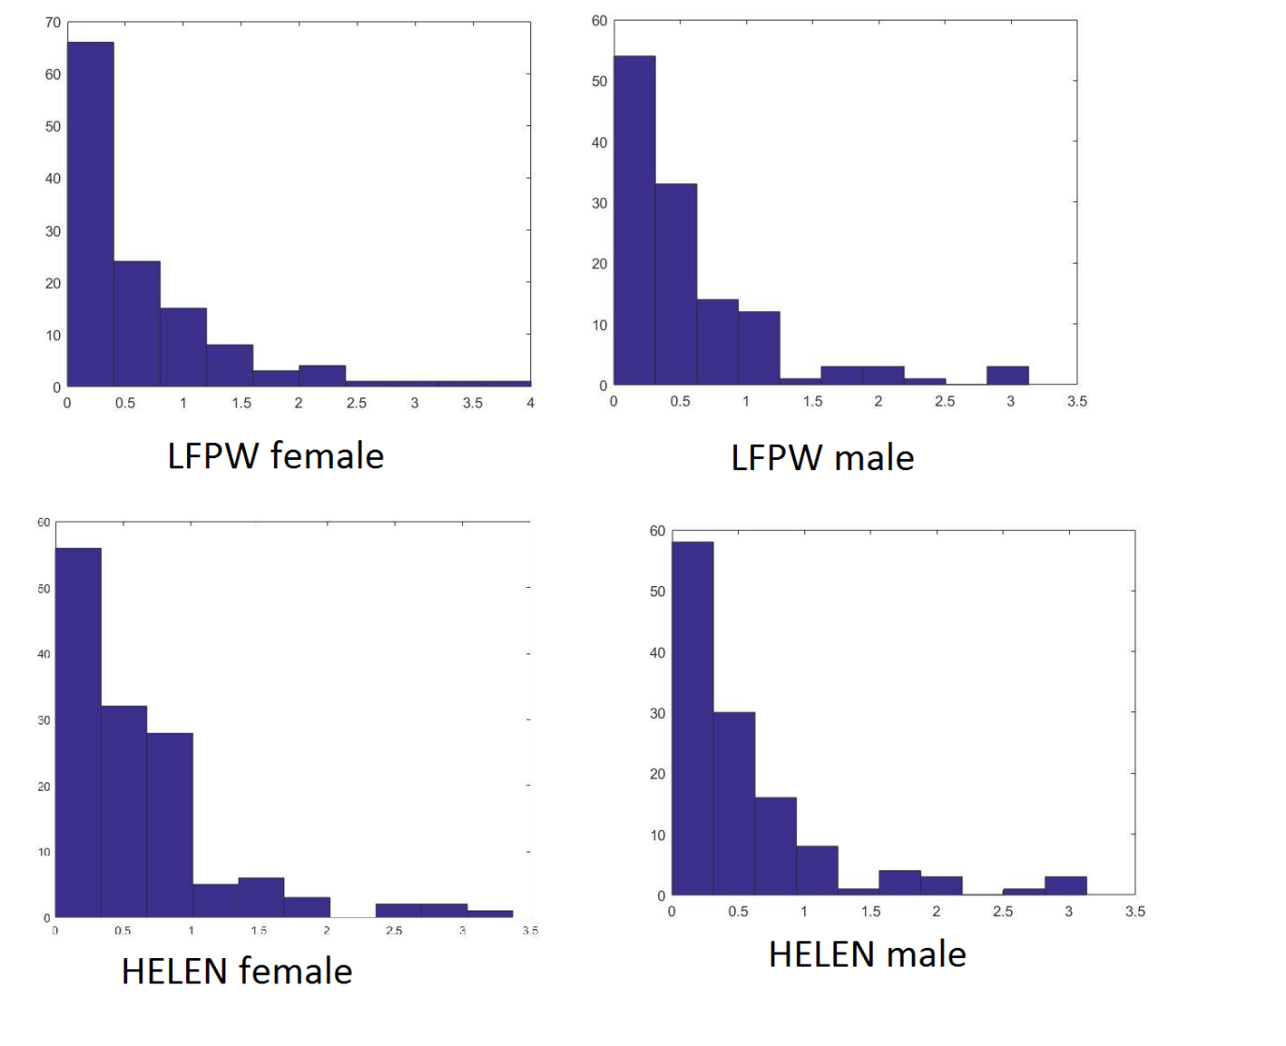

Slide 21
Reflection of successes
Overall, we believe our project was a success.
All requirements fulfilled.

Slide 22
Demo

Slide 23
Questions?

